Slide 1
Build a Strong MERN Foundation
Notes:
Trainer Notes:
This slide is self-explanatory, trainer notes not required.

Slide 2
Online Banking Web Application

Slide 3
Adding Dynamic Functionality Using JavaScript

Slide 4

Before we begin, let’s recall what we have covered till now:​

Slide 5
JavaScript
JavaScript is a high-level, interpreted programming language that is primarily used to enhance interactivity on web pages. It enables dynamic content and user interaction by allowing the manipulation of webpage elements in response to user actions.

Slide 6
A Day in the Life of a MERN Stack Developer
The designing of the static web page is done using HTML and CSS.
The next step is to add dynamic behavior to the web page using JavaScript. It will be used to create the user interface, server-side and client-side processing, database interaction, and responsive design.

Slide 7

Identify key JavaScript functions and syntax used in dynamic web development
Implement JavaScript to create interactive features in a banking web application
Investigate JavaScript code to identify and solve issues related to website performance and user interaction
Develop a comprehensive and dynamic banking web application using JavaScript

Slide 8
Task: Integrate JavaScript for Dynamic Behavior

Slide 9
Create a JavaScript File for Login Functionalities
Create a JavaScript file for the following admin login functionalities:
The admin credentials are hard-coded and checked on the client side using JavaScript.
If the credentials are correct, the admin is redirected to the home page.
If the credentials are incorrect, an error message is displayed.
The admin can view all account details, which are stored in an array as dummy data.
The admin has the option to log out of the web page.

Slide 10
Create a JavaScript File for Login Functionalities
Create a JavaScript file for the following customer login functionalities:
Customer logs in using a dummy account stored in an array.
Customer login is successful, only If the account is valid.
Customer can view their account details.
Customer can access the transaction details.
Static web pages assist with transactions such as transfers, balance checks, withdrawals, and deposits.

Slide 11
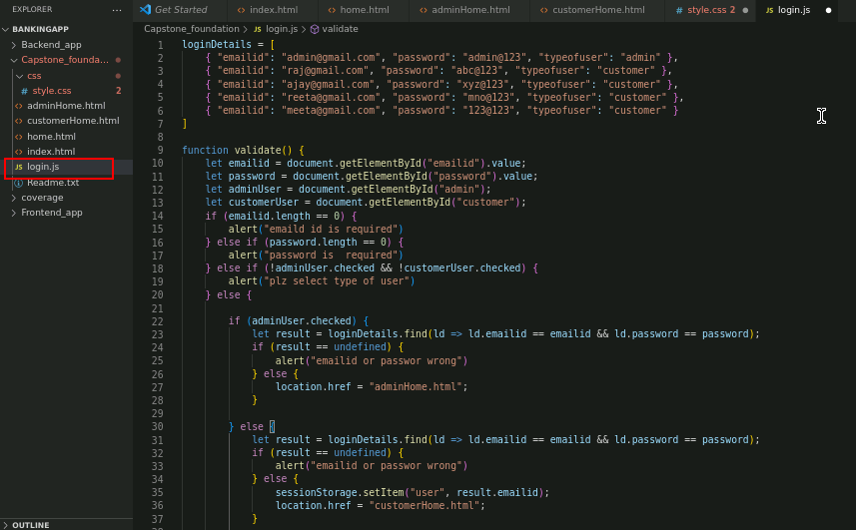
Create a JavaScript File for Login Functionalities
Create a login.js file for the following login validation functionalities: admin and customer user type distinction, email ID validation and password validation

Slide 12
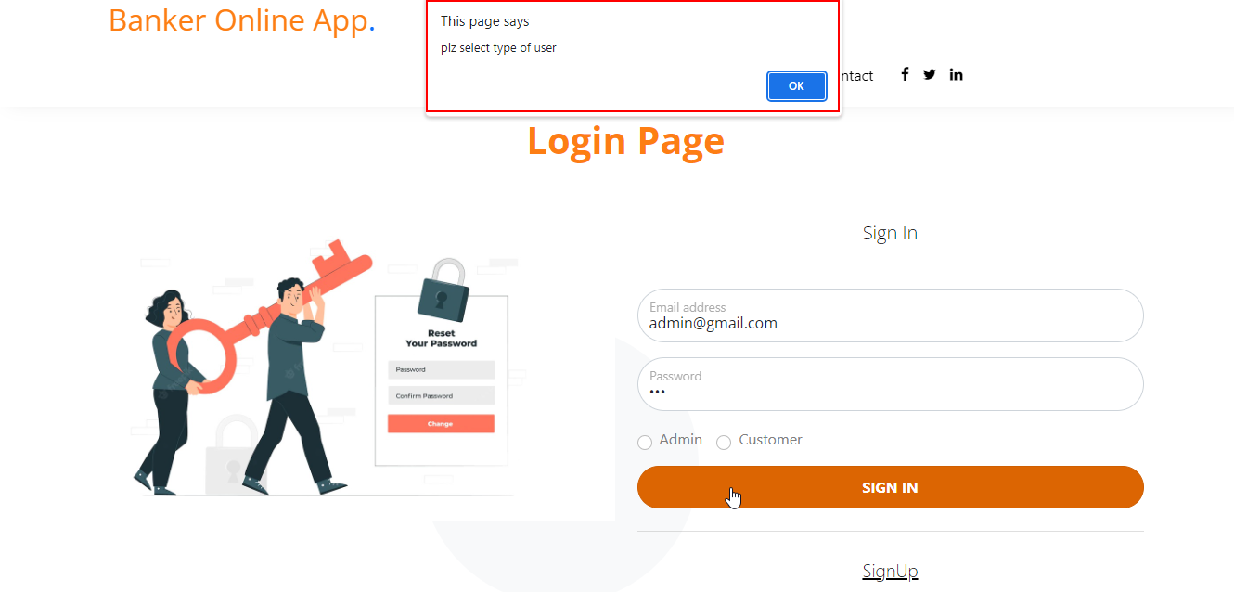
Create a JavaScript File for Login Functionalities
The login page prompts for the user type selection validation.

Slide 13
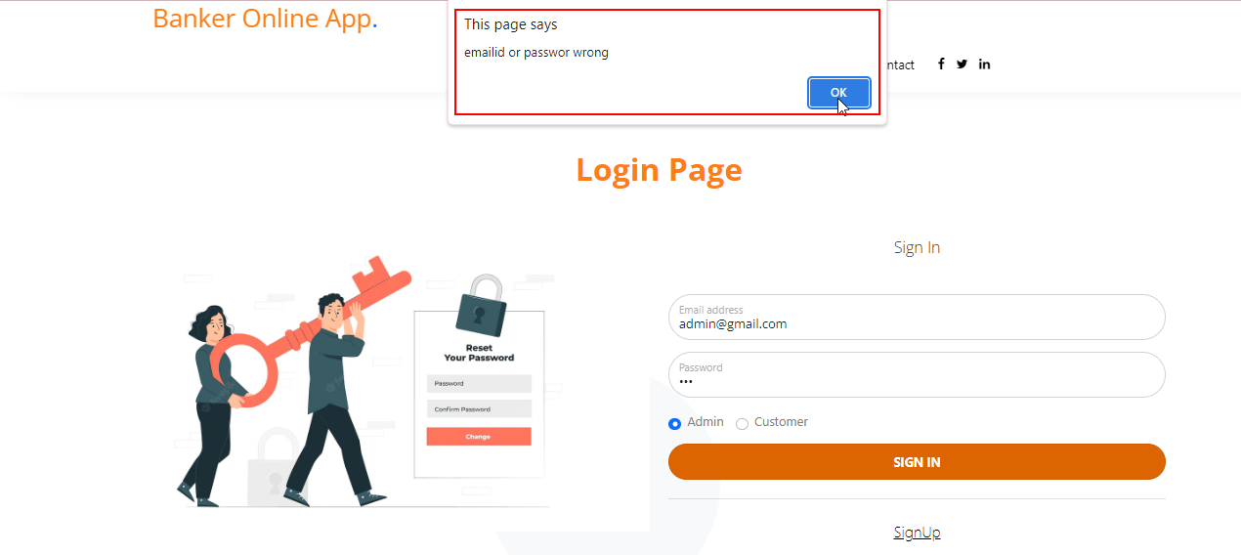
Create a JavaScript File for Login Functionalities
The login page prompts for the email ID and password validation for the admin login.

Slide 14
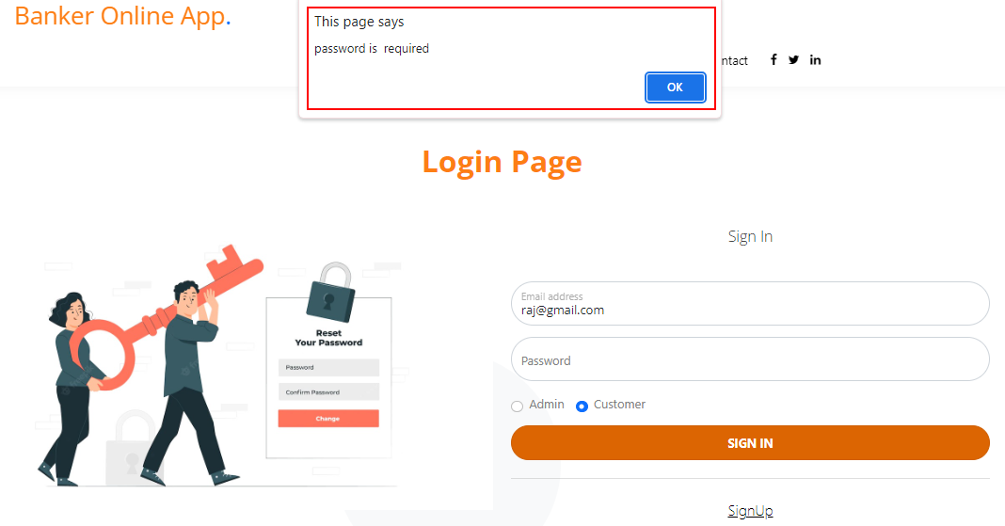
Create a JavaScript File for Login Functionalities
The login page prompts that a password is required for any type of user login.

Slide 15
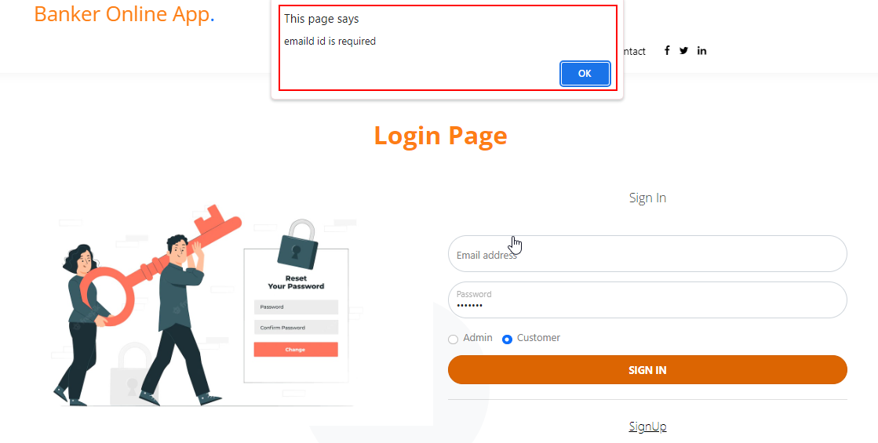
Create a JavaScript File for Login Functionalities
The login page prompts that an email ID is required for any type of user login.

Slide 16
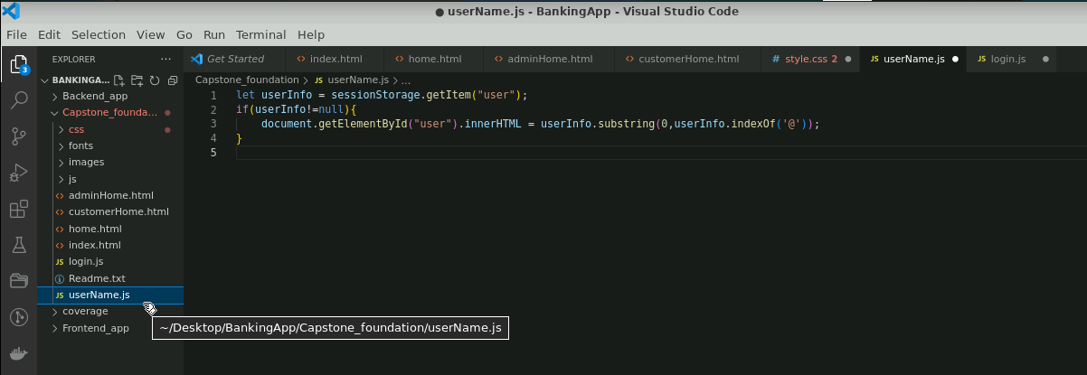
Retrieve Username from the Current Session
Create a userName.js file that retrieves a value from the session storage, and extracts the username portion of the value
This username will be displayed on the customer home page.

Slide 17
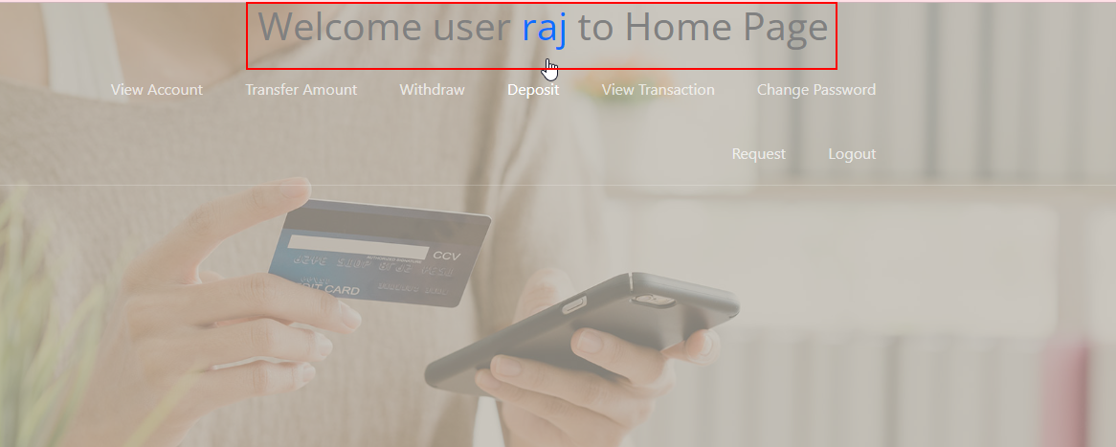
Retrieve Username from the Current Session
The retrieved username is displayed on the customer home page.

Slide 18
Conclusion
By the end of the session, it is expected that:
All types of login validations must be done through HTML or JavaScript.
An appropriate error message must be displayed for all types of login validations.
The static data must be loaded from the array using JavaScript and displayed on the web pages.

Slide 19
Thank you

